Slide 1

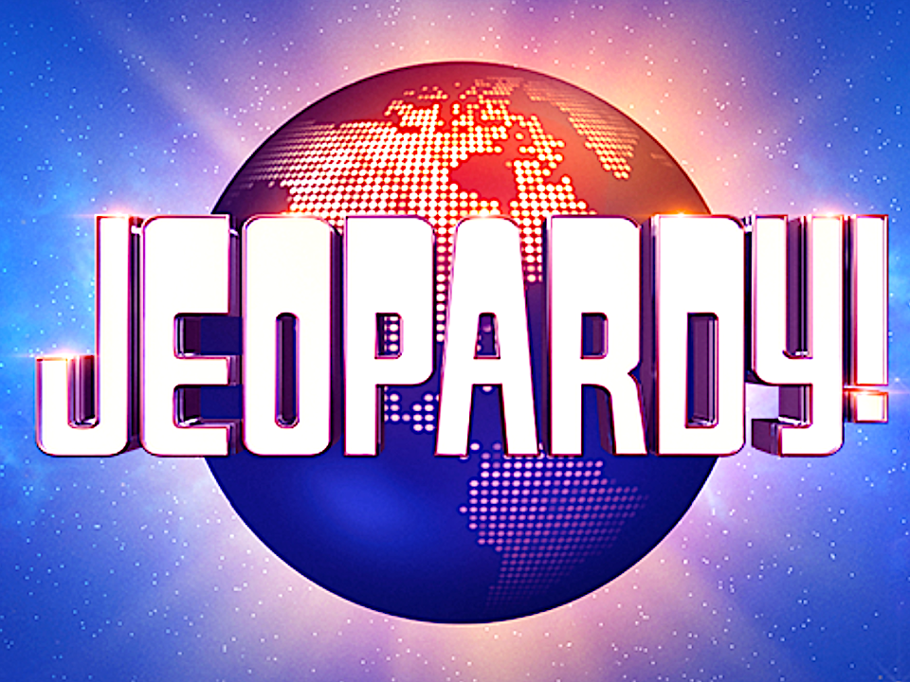
Jeopardy! Analysis
By Jeffery Huang

Slide 2

Goal:
What are the Top categories in jeopardy history VS. in the recent decade?
What are the most common words for all the jeopardy questions?

Slide 3
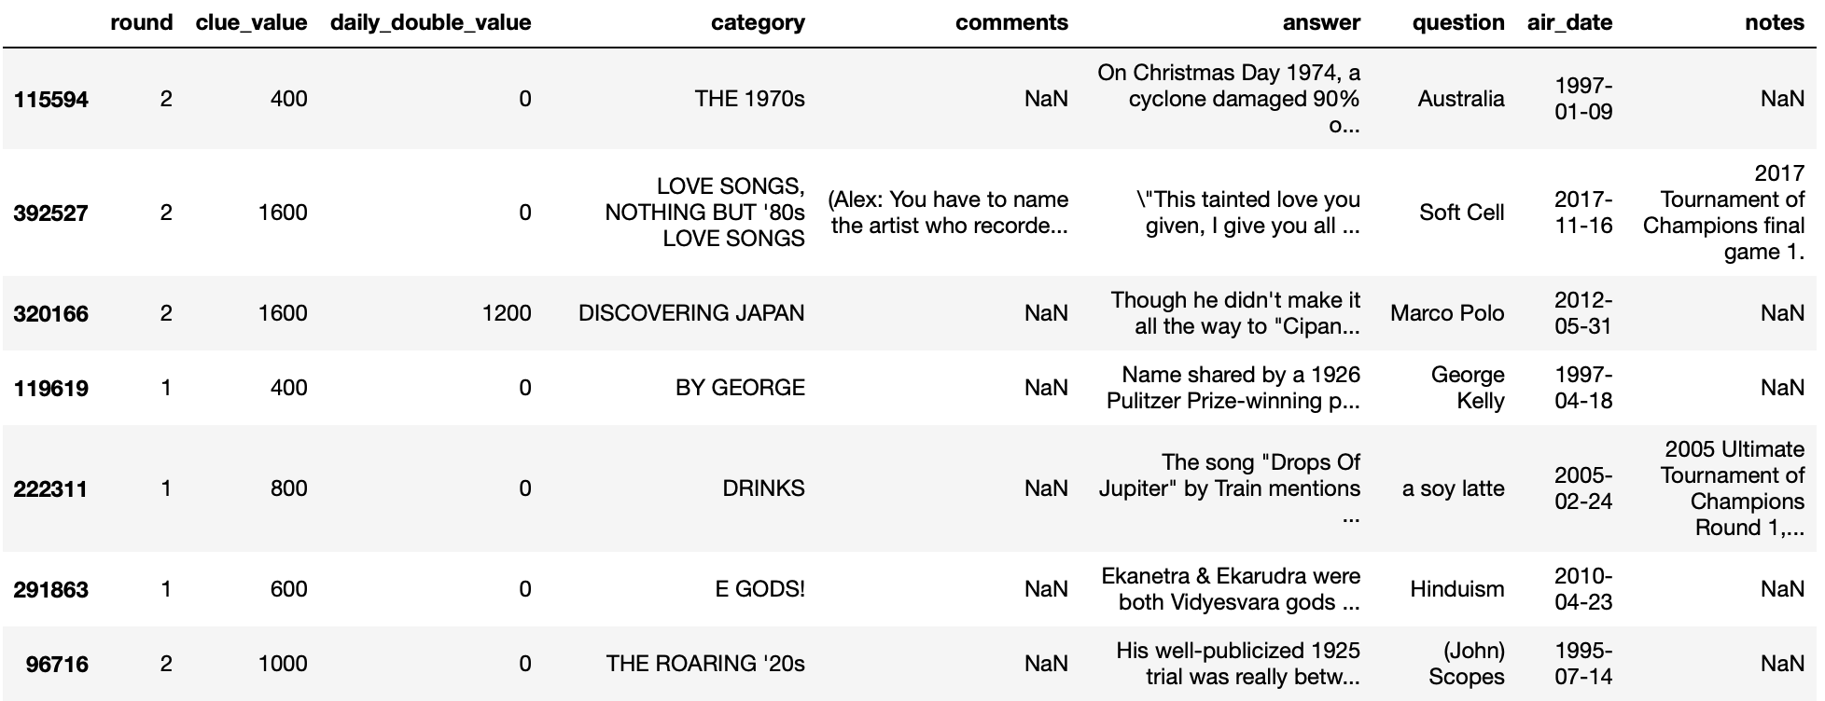
About the Dataset
Source: Kaggle
Number of Rows: 468,317
Columns: round, clue value, daily double value, category, comments, answer, question, air date, notes
Main Columns for Analysis: category, answer, question, air date

Slide 4
What are the Top 10 categories in jeopardy history VS. in the recent decade?

Slide 5
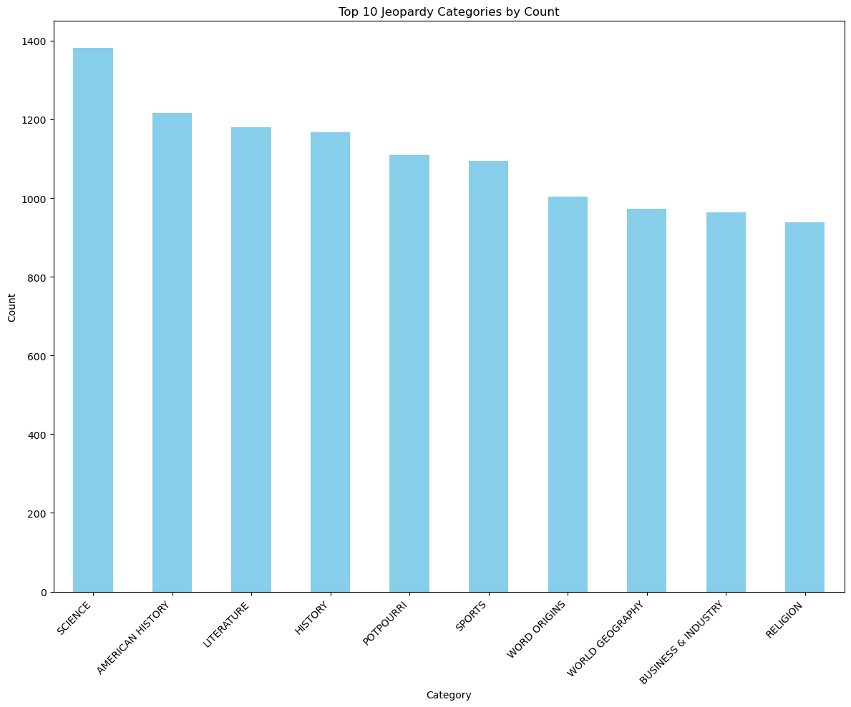

Slide 6
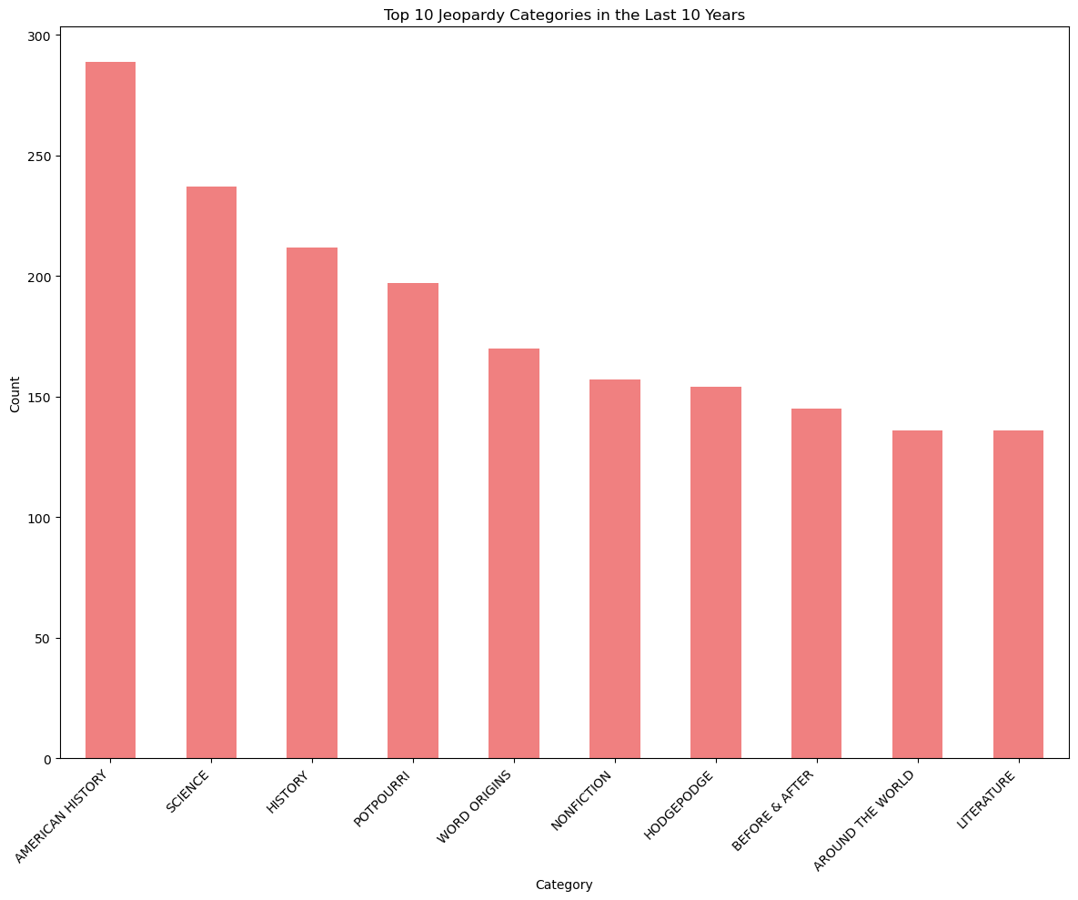

Slide 7
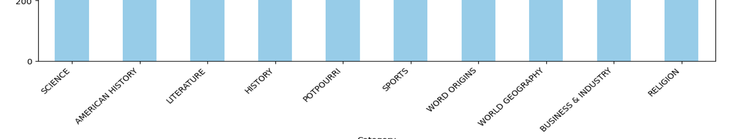
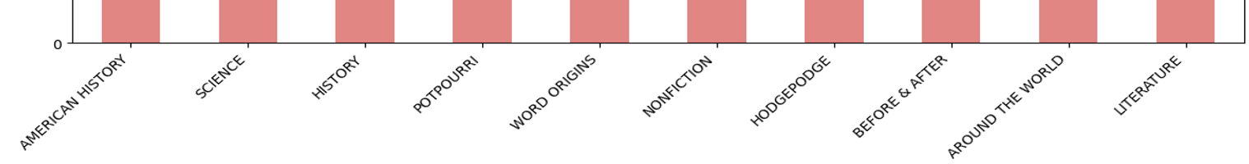
Top 10 of all time (big picture)
Recent 10 years Snoopy’s owner who’s a large forest-dwelling ursine creature: Charlie Brown Bear

Slide 8
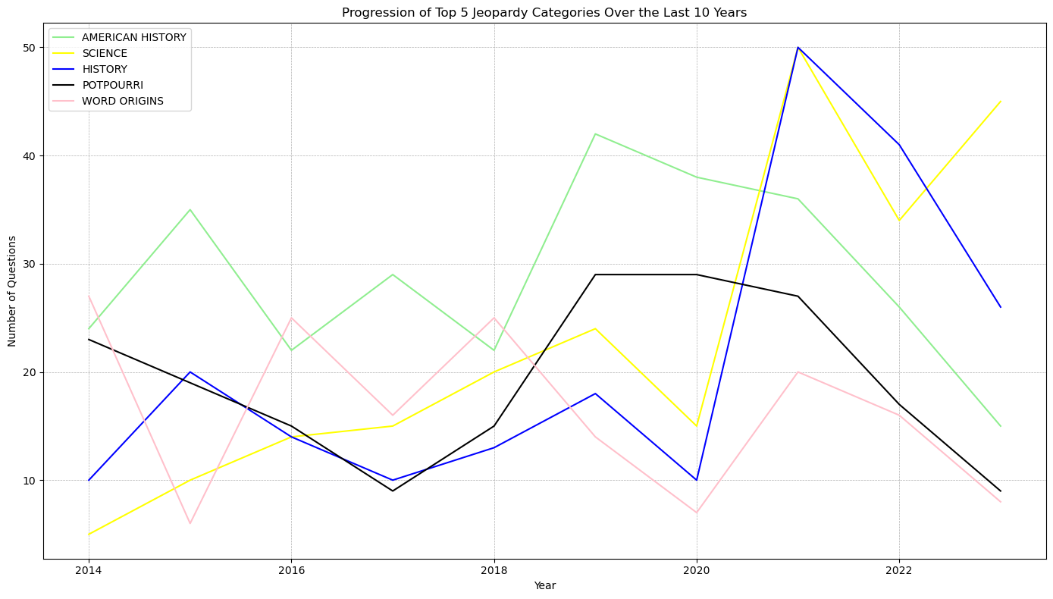

Slide 9
What are the most common words for all the jeopardy Questions?

Slide 10
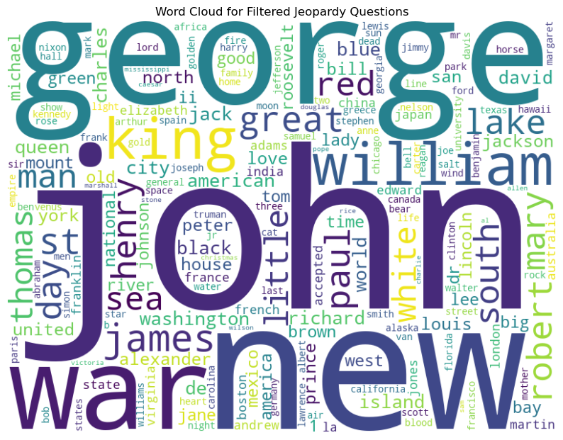

Slide 11
Takeaways
1. Consistent Interest in Core Subjects: Categories like "SCIENCE", "AMERICAN HISTORY", "HISTORY", "POTPOURRI", and "LITERATURE" have remained popular throughout Jeopardy's history and in the recent decade.
2. Emerging Categories: Categories like "NONFICTION", "HODGEPODGE", "BEFORE & AFTER", and "AROUND THE WORLD" have gained prominence in the recent decade, suggesting a diversification of topics
3. Waning Interest in Some Traditional Subjects: "WORLD GEOGRAPHY", "BUSINESS & INDUSTRY", and "RELIGION", which were among the top categories historically, are absent from the top categories in the recent decade. This could indicate a change in the show's strategy or reflect evolving viewer interests.
4. Jeopardy is all about history/science

